Slide 1
Comp 1123 Software Installation Guide

Slide 2
Notes
If you run into problems, see the lab consultant in CAR 209 for help
Need to install the following:
Java
Apple users should already have Java installed and can skip this step
If you took Comp 1113 in the fall, you already have Java installed.
Dr Java

Slide 3
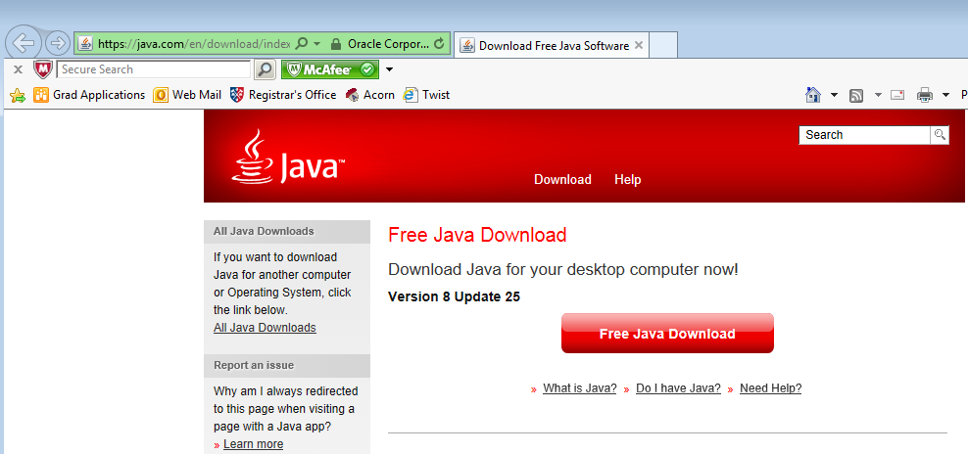
Java – Apple users and students from last term can skip this step
Go to: https://java.com/en/download/index.jsp
Click and run

Slide 4
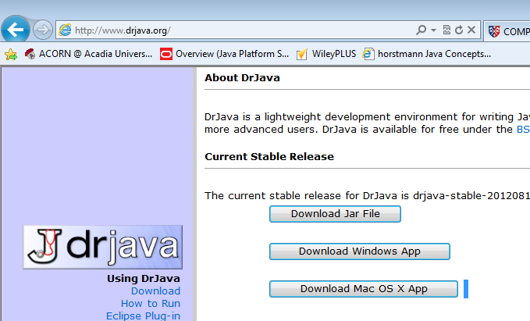
Dr Java
www.drjava.org

Slide 5
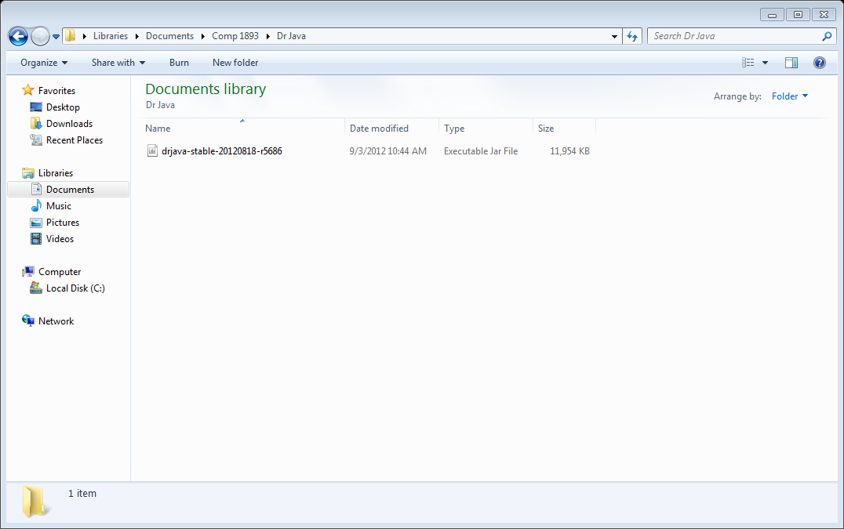
“Save as” in a “Dr Java” folder

Slide 6
Shortcut
Right click on the Dr Java jar file
Create Shortcut
Put it on the desktop

Slide 7
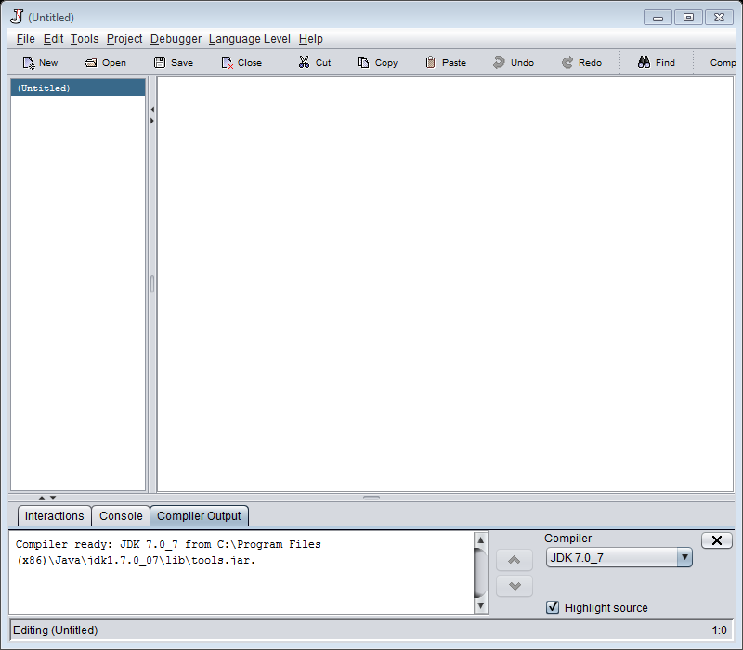
Testing: double click on the file in the Dr Java folder

Slide 8
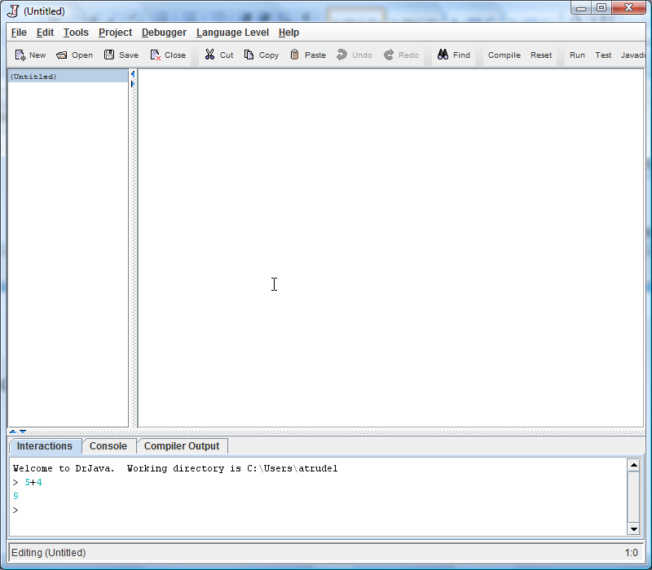
Does it run?

Slide 9
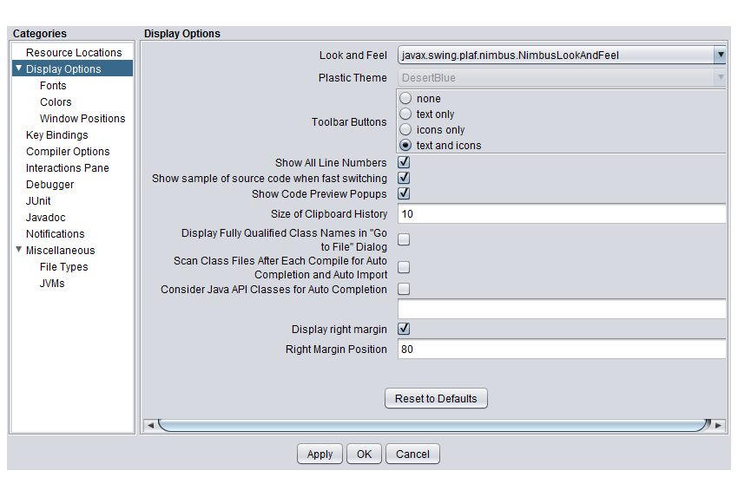
Edit - Preferences

Slide 10
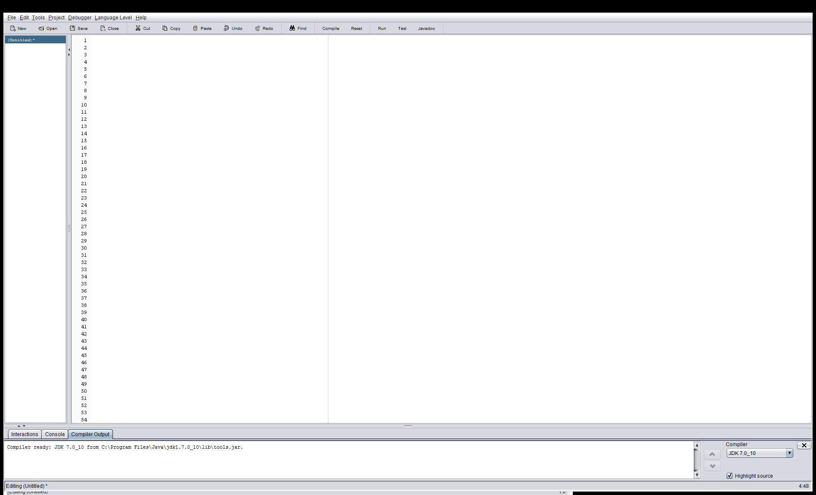
Result

